Slide 1
MIS 321
PA5
Fall - 2023

Slide 2
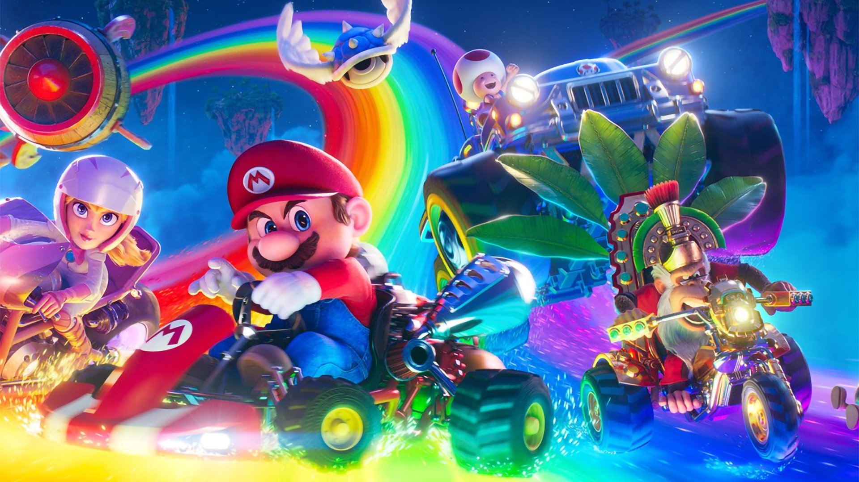
Super Mario Bros.

Slide 3
Background
Inspired by Mario Smash Bros, we want to build a game simulating the battle scenes pictured in Super Mario Bros.
In this assignment, you’ll create a simplified version of the game. In this game the user will be able to:
Select a character to join the fight with
Attack / defend as appropriate on a rotating basis with your opponent
View the current stats of both characters in the fight at any time

Slide 4
Project Goals
The primary goal of this project is to see the power of good design with a focus on learning to utilize inheritance and interfaces.
To meet these goals, the project will be broken into two parts.
Part 1 is to create the UML diagrams for the project
Part 1 must be reviewed by at TA (Anne, Jaehee, or Andrew) and confirmed as correct before moving to part 2 - Improper design will not receive credit, even if the functionality is correct

Slide 5
Base Play
Each character should have a:
Name
Max power for the character
Health
Attack strength
Defensive power
Each character should also have the ability to attack and defend. The type of attack varies by character.

Slide 6
Base Play
The character should provide stats when requested
The maximum power for a character should be set to a random number between 1 and 100
Health should start at 100 when the character is instantiated
Attack strength & defensive power should be a random number between 1 and max power for the character

Slide 7
Base Play
The game should be between 2 players
The game should prompt each player for their name
The game should randomly choose which character attacks first
The players alternate attacks until a character’s health reaches 0
On each attack write the power and the damage done to the screen, then display the attacked character’s stats

Slide 8
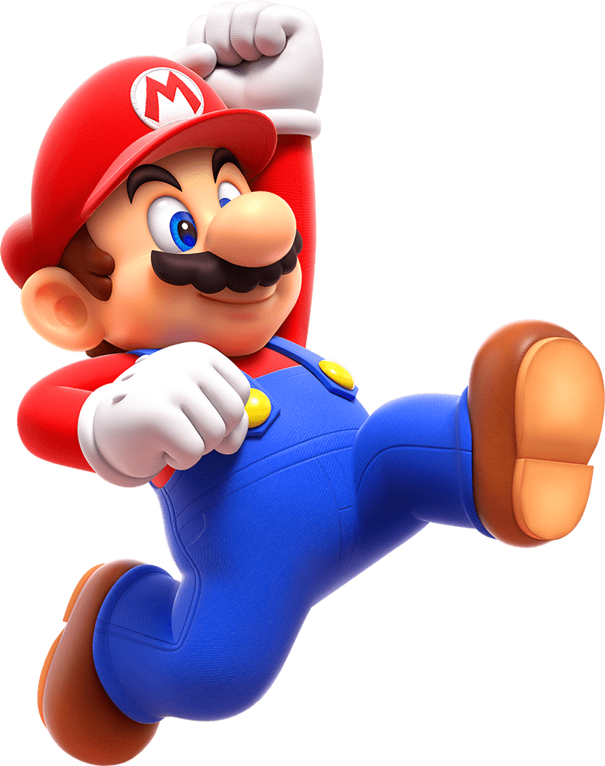
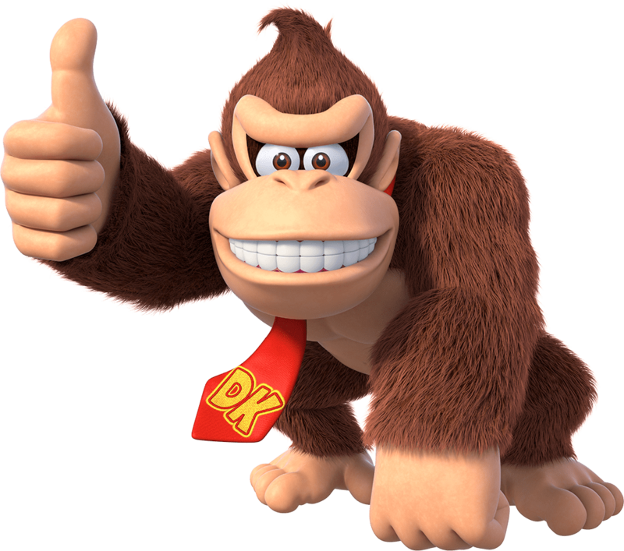
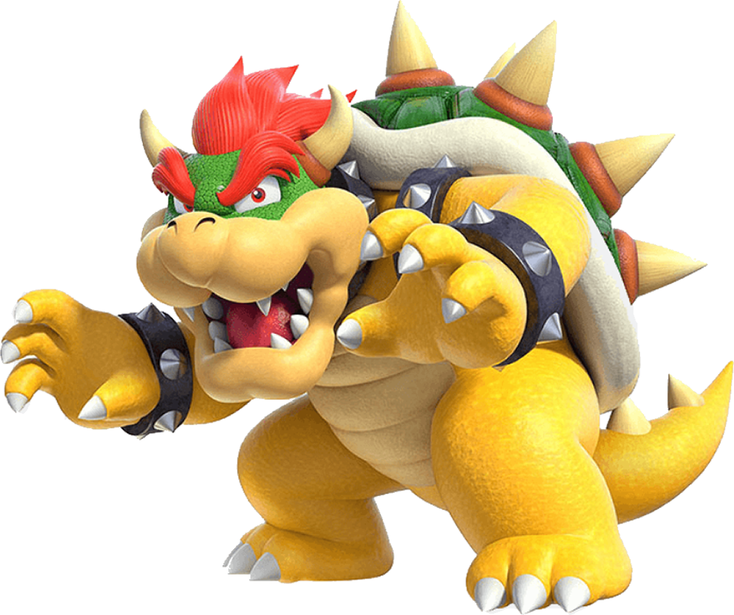
Base Requirements
There should be various character types a player can choose from:
Mario
Fire Flower
Donkey Kong
Primate Punch
Bowser
Super Crown

Slide 9
Base Requirements
Each character has a different primary attack
Attack effectiveness varies based on the type of attack and the type of character being attacked.
Mario beats Bowser, Donkey Kong beats Mario
These combinations get a 20% boost

Slide 10
Damage Calculations
If the attacker’s type beats the defender’s type, the Type Bonus is 1.2; otherwise, the Type Bonus is 1
An attack should deal damage equal to the following:
Damage Dealt = (Attacker’s Attack Power –Defender’s Defense Power) * (Type Bonus)

Slide 11
Extra Credit: Have fun – Be Creative
Extend your project with new attack types, give a character more than 1 type of attack to choose from, etc.
Create new characters
Build an AI and play against the computer
Allow a player to have an assortment of characters they can pick which one to play between each round
Etc.

Slide 12
Grading
Activity | Points
UML | 15
Properly creating classes | 25
Properly encapsulating behaviors | 30
Game play | 30
Project is worth 100 points. Extras are for extra credit. Up to 20 extra credit points possible.

Slide 13
Administration
https://classroom.github.com/a/tDkgOu4H
Due 11/9 at 12:30 PM
Submit UML to Blackboard along with github link (all in the same document!) (must still get UML approved beforehand)

Slide 14
Questions

